Slide 1
Project Selection
Three main categories of methods/approaches:
Strategic approach
Analytical approach
Financial methods

Slide 2
Project Selection
Financial methods of project appraisal:
Payback period
Return on investment
Net Present Value (NPV)
Internal Rate of Return (IRR)
The common limiting factor for all of them is that they are based on a forecasted cash flow.

Slide 3
Project Selection
1. Payback Period
The payback period is the time taken to gain a financial return equal to the original investment. It is usually expressed in years and months.
“Time needed to get your money back” (the original investment – without any profit).

Slide 4
Payback Period
Example
Our company wants to buy a new machine for a four year project. We have to choose between machine A or machine B, so it is mutually exclusive situation. Both machines have the same initial cost $35000, but their cash flows are different over the four year period.
Year | Machine A Cash Flow | Machine B Cash Flow
0 | -35000 | -35000
1 | 20000 | 10000
2 | 15000 | 10000
3 | 10000 | 15000
4 | 10000 | 25000

Slide 5
Payback Period
Example
Payback period calculation
Year | Machine A Cash Flow | Machine A CF Cumulative | Machine B Cash Flow | Machine B CF Cumulative
0 | -35000 | -35000 | -35000 | -35000
1 | 20000 | -15000 | 10000 | -25000
2 | 15000 | 0 | 10000 | -15000
3 | 10000 | 10000 | 15000 | 0
4 | 10000 | 20000 | 25000 | 25000

Slide 6
Payback Period
Example
Payback period for machine A is 2 years, while the payback period for machine B is 3 years.
Machine A will recover its outlay sooner than machine B, i.e. if projects are ranked by the shortest payback period, machine A is selected in preference to machine B.

Slide 7
Payback Period
The advantages of the payback method:
simple and easy to use
reduces the project’s exposure to risk and uncertainty by preferring the project that has the shortest payback period
faster payback has a favourable short-term effect on earnings per share
the payback period quantifies the selection criteria in terms the managers are familiar with

Slide 8
Payback Period
The disadvantages of the payback method:
it does not take into account the time value of money
it is not suitable technique to evaluate long term projects where the effects of inflation and interest rates could significantly change the results
it is based on project cash flow only because all other financial data are ignored
although payback period would reduce the duration of risk (by preferring shorter projects), it does not quantify the risk exposure

Slide 9
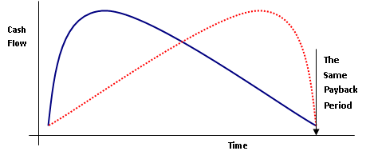
Payback Period
The disadvantages of the payback method:
it is indifferent to the timing of the cash flows (the project with high early repayments would be ranked equally with a project which had late repayments if their payback period were the same)

Slide 10
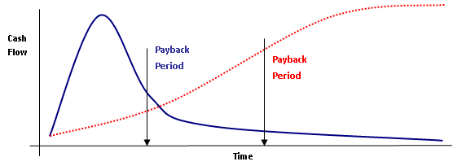
Payback Period
The disadvantages of the payback method:
the cash flow after the payback period is not considered (the red project below would be rejected in favour of the blue project with higher early returns)

Slide 11
Payback Period
Summary:
the most widely used technique, even if this use is only an initial filter for project selection
simple, quick and easy to use (can be worked out on a slip of paper)
Example: Select the best project according PB criteria
Year | 0 | 1 | 2 | 3 | 4 | 5
Project 1 | -20000 | 5000 | 10000 | 5000 | 5000 | 7000
Project 2 | -25000 | 7000 | 7000 | 7000 | 7000 | 5000
Project 3 | -15000 | 1000 | 5000 | 3000 | 4000 | 2000

Slide 12


Project Selection
2. Return on Investment (ROI)
ROI is very popular method that looks at the whole project.
It is based on calculation of the average annual profit which is converted into a percentage of the total outlay using the following formulas:

Slide 13
Return on Investment
Example
Our company wants to buy a new machine for a four year project. We have to choose between machine A or machine B, so it is mutually exclusive situation. Both machines have the same initial cost $35000, but their cash flows are different over the four year period.
Year | Machine A Cash Flow | Machine B Cash Flow
0 | -35000 | -35000
1 | 20000 | 10000
2 | 15000 | 10000
3 | 10000 | 15000
4 | 10000 | 25000

Slide 14
Return on Investment
Example
First of all, we need to calculate the total gains for each project.
It is the sum of cash flow – we do not include original outlay (original investment) into this sum
Year | Machine A Cash Flow | Machine B Cash Flow
0 | -35000 | -35000
1 | 20000 | 10000
2 | 15000 | 10000
3 | 10000 | 15000
4 | 10000 | 25000
Total Gains | 55000 | 60000

Slide 15
Return on Investment
Example
Using the above defined formulas we can easily get
Average Annual Profit_{A} = (55 000 – 35 000)/4 = 20 000/4 = 5000
ROI_{A} = (5 000 / 35 000)*100 = 14,3%
Average Annual Profit_{B} = (60 000 – 35 000)/4 = 25 000/4 = 6250
ROI_{B} = (6 250 / 35 000)*100 = 17,8%
ROI is higher for the project B because it creates higher cumulative profit over and the initial outlays are equal. According the ROI, project B should be preferred.

Slide 16
Return on Investment
The advantages of the ROI method:
simple and easy to use
it considers the cash flow over the whole project
the result is expressed as a profit and percentage return on investment and both parameters are readily understood by managers

Slide 17
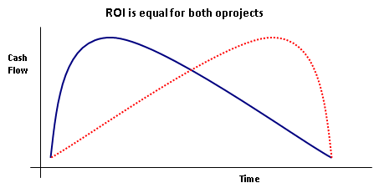
Return on Investment
The disadvantages of the ROI method:
it averages out the profit over successive years
an investment with high initial profits would be ranked equally with a project with high late profits if the average profit was the same (time value of money is ignored)

Slide 18
Project Selection
Task
Calculate the payback period and ROI for the following two projects and suggest which one would you prefer and why.
Year | Project A | Project B
0 | -100 000 | -80 000
1 | 30 000 | 40 000
2 | 30 000 | 20 000
3 | 30 000 | 20 000
4 | -10 000 | -20 000
5 | 30 000 | 10 000
6 | 30 000 | 10 000
7 | 20 000 | 0

Slide 19
Project Selection
Homework
Calculate the payback period and ROI for the following three projects and suggest which one would you prefer and why.
Year | Project A | Project B | Project C
0 | -10 000 | -15 000 | -15 000
1 | 4 000 | 5 000 | 6 000
2 | 2 000 | 5 000 | 7 000
3 | 2 000 | 3 000 | 4 000
4 | -1 000 | 2 000 | 1 000
5 | 3 000 | 1 000 | -1 000
6 | 2 000 | 1 000 | -1 000

